Slide 1

CMP3103M Autonomous Mobile Robotics -Assessment Item 1
By Daniel Dixon 16602092

Slide 2
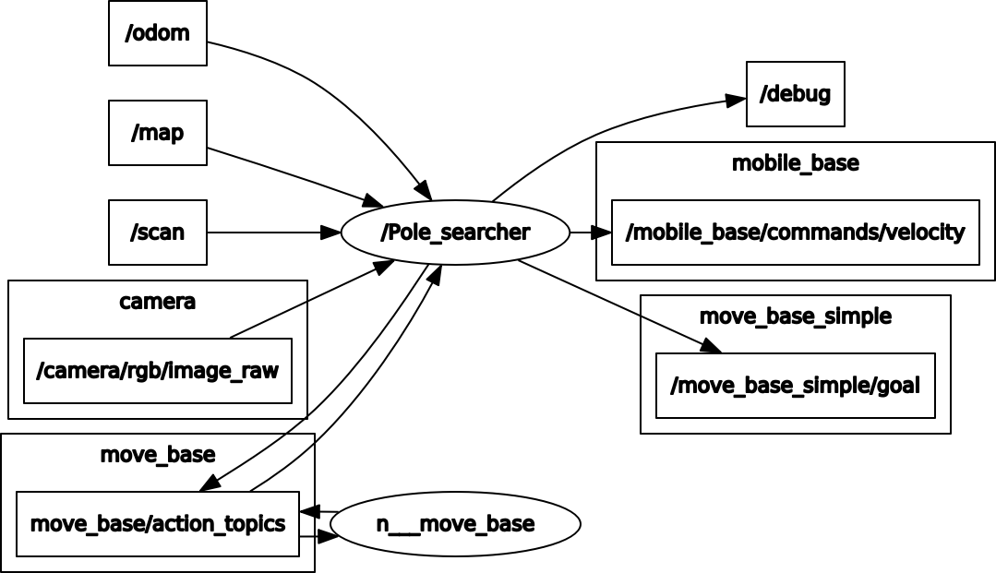
Design and Implementation
Imported/Subscribed
Image – Used to create masks
Scan – Used to calculate distance
Move_base – Used to create a client
Exported/Published
Debug – String Publisher that states which poles have been found
Mobile_base – Data published to here for movement
Other topics shown would have been used for further inmplimentation

Slide 3
Evaluation
Results:
All four objects found
Time Taken without poles: (mm:ss:msms)03:30:69
Time Taken with poles: (mm:ss:msms)03:06:45
Taken less time with poles as all poles found before route completed
Improving efficiency:
Visit less locations
Don’t have robot turning to initial orientation at each location
Spin at each location combined with smaller minimum mask area
Limitations of code:
Map – Although attempts at implementation, code is not resilient to changes in the map
Object Avoidance – If object to be found is at a certain point where enough is showing but an object is in the way it will bang into that object
Move_base Integration with Twist Movement - The twist movement that takes place when moving towards the poles can cause the mapping to need a reset by move_base. To combat this an implementation that calculated the distance away from the object and then recursively computed a move_base goal closer and closer to the object until the turtlebot was less than a metre away

